Slide 1
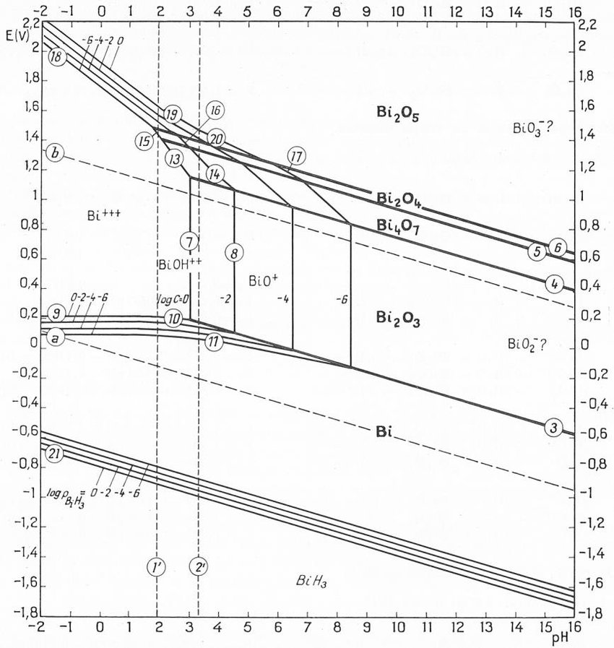
Exercise1: Pourbaix diagram
You want to electrodeposit bismuth from an aqueous electrolyte and you want to choose the ideal pH.
You decide to refer to the E-pH thermodynamic equilibriums found in Pourbaix diagram.
You find the Pourbaix diagram for Bi³⁺ in pure water at ambient conditions:
4
5
3
1
2
6
What represent the vertical, horizontal, and diagonal lines. Why are their duplicated lines?
What are the diagonal dashed lines? Write the reactions? Name the space defined between them.
Write the reactions that occur at the transitions 1, 2, 3, 4, 5, and 6
Determine their slope.
From the Pourbaix diagram, propose boundary conditions on E, pH and [Bi³⁺] for the electrodeposition of Bi⁰

Slide 2
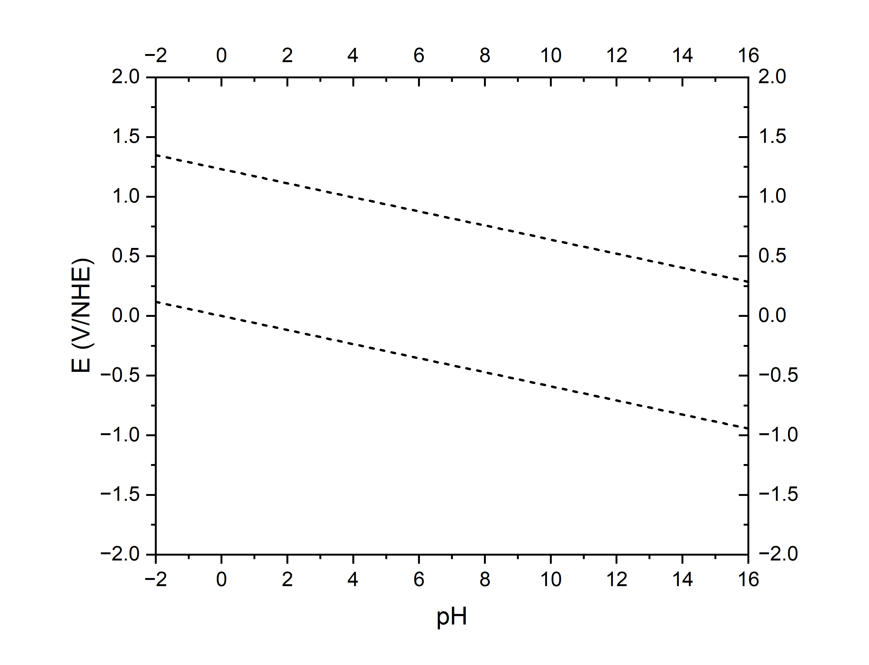
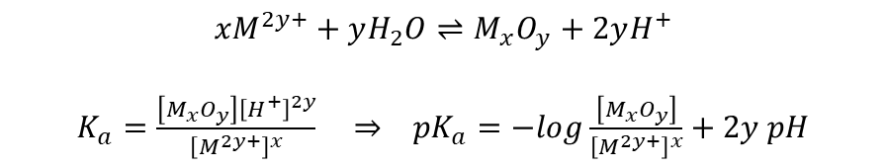


How to build a Pourbaix diagram (E-pH)
$${xM}^{2y+}+yH_{2}O⇌M_{x}O_{y}+2yH^{+}$$
$K_{a}=\frac{\left[M_{x}O_{y}\right]{\left[H^{+}\right]}^{2y}}{{\left[M^{2y+}\right]}^{x}}$ $⇒ {pK}_{a}=−log\frac{\left[M_{x}O_{y}\right]}{{\left[M^{2y+}\right]}^{x}}+2y pH$
Acidity constants
Nernst Potentials
$$E^{eq}=E^{0}−2.303\frac{RT}{nF}log\frac{a_{Red}}{a_{Ox}}$$
At 25 °C, $2.303\frac{RT}{F}≈0.059 V$

Slide 3
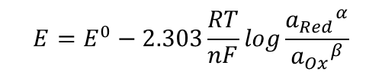
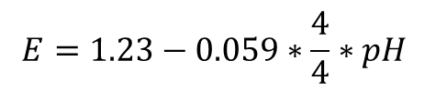
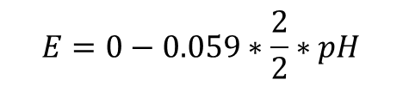
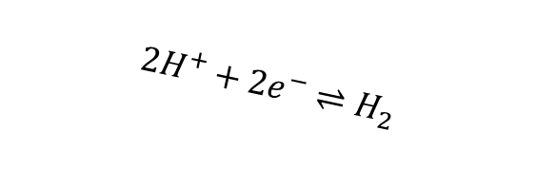
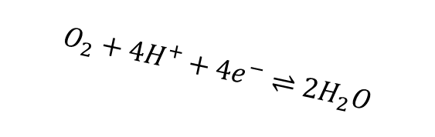
How to build a Pourbaix diagram (E-pH)
Acidity constants
Nernst Potentials
$$O_{2}+{4H}^{+}+4e^{−}⇌2H_{2}O$$
$$E=E^{0}−2.303\frac{RT}{nF}log\frac{{a_{Red}}^{α}}{{a_{Ox}}^{β}}$$
$$E=1.23−0.059∗\frac{4}{4}∗pH$$
Electrochemical window of water
$${2H}^{+}+2e^{−}⇌H_{2}$$
$$E=0−0.059∗\frac{2}{2}∗pH$$
At 25 °C, $2.303\frac{RT}{F}≈0.059 V$

Slide 4

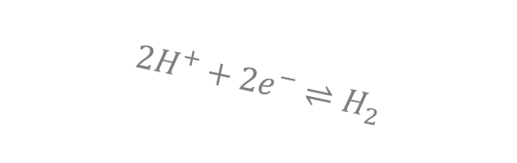

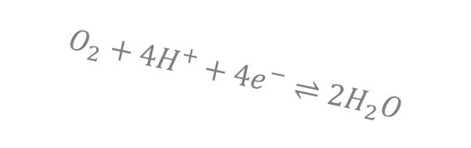
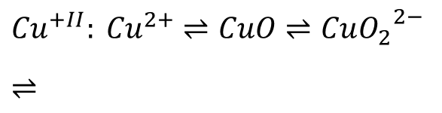
How to build a Pourbaix diagram (E-pH)
Acid-base equilibria
$${Cu}^{2+}⇌CuO⇌Cu{O_{2}}^{2−}$$
Acidity constants
$${Cu}^{+}⇌{Cu}_{2}O$$
Nernst Potentials
$$O_{2}+{4H}^{+}+4e^{−}⇌2H_{2}O$$
Redox
$${Cu}^{+II}: {Cu}^{2+}⇌CuO⇌Cu{O_{2}}^{2−}$$
$$⇌$$
$${2H}^{+}+2e^{−}⇌H_{2}$$
$${Cu}^{+I}: {Cu}^{+}⇌{Cu}_{2}O$$
$$⇌$$
$${Cu}^{0}$$
At 25 °C, $2.303\frac{RT}{F}≈0.059 V$

Slide 5
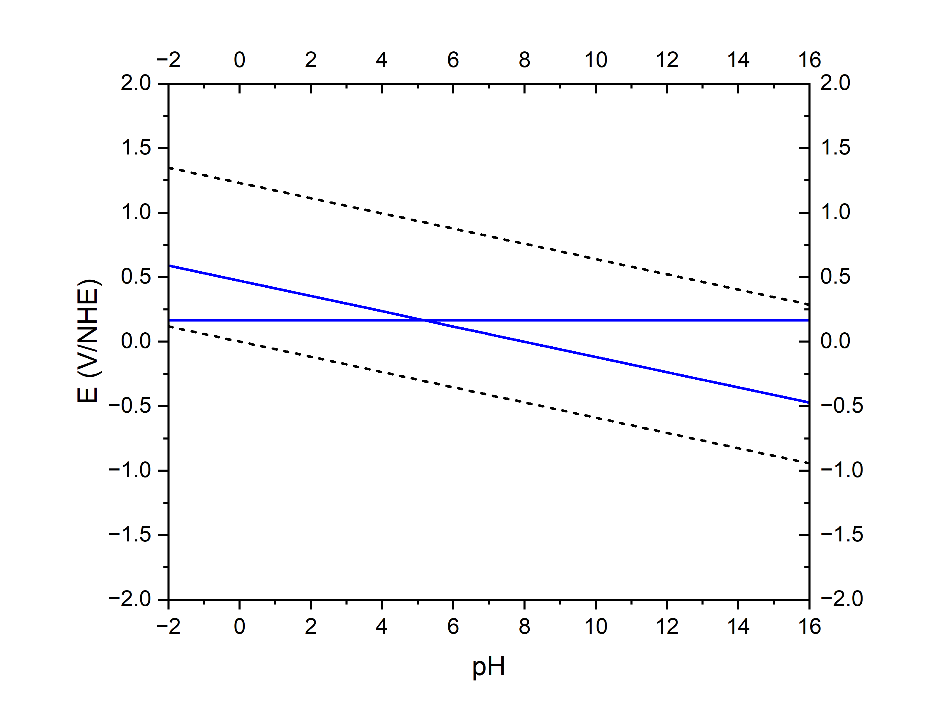


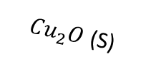
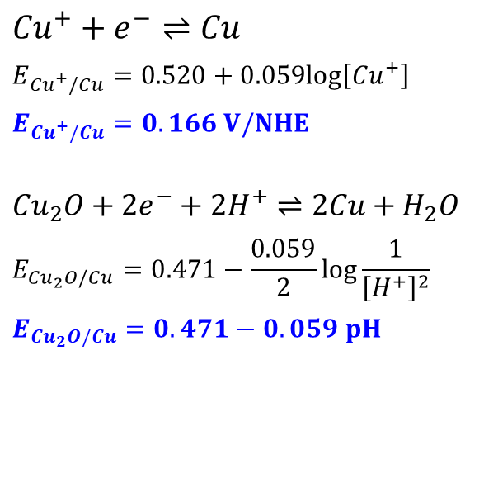

How to build a Pourbaix diagram (E-pH)
Acid-base equilibria
$${Cu}^{2+}⇌CuO⇌Cu{O_{2}}^{2−}$$
Acidity constants
$${Cu}^{+}⇌{Cu}_{2}O$$
Nernst Potentials
$$O_{2}+{4H}^{+}+4e^{−}⇌2H_{2}O$$
Redox Cu^{+I}/Cu⁰
$${Cu}^{+}+e^{−}⇌Cu$$
$$E_{{Cu}^{+}/Cu}=0.520+0.059log⁡\left[{Cu}^{+}\right]$$
$E_{{Cu}^{+}/Cu}=0.166 V/NHE$
$${Cu}_{2}O+2e^{−}+2H^{+}⇌2Cu+H_{2}O$$
$$E_{{Cu}_{2}O/Cu}=0.471−\frac{0.059}{2}log\frac{1}{{\left[H^{+}\right]}^{2}}$$
$$E_{{Cu}_{2}O/Cu}=0.471−0.059 pH$$
$${Cu}^{+}$$
${Cu}_{2}O$ (S)
$${2H}^{+}+2e^{−}⇌H_{2}$$
$${Cu}^{0}$$
At 25 °C, $2.303\frac{RT}{F}≈0.059 V$ [Cu]=10⁻⁶ mol/L

Slide 6
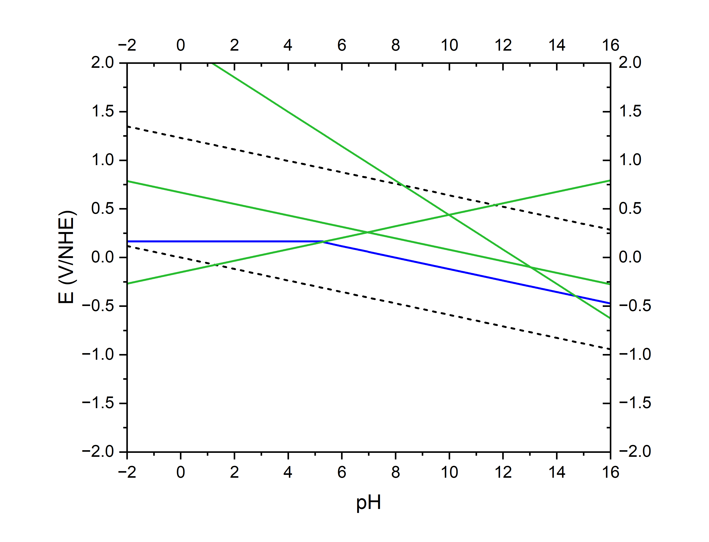


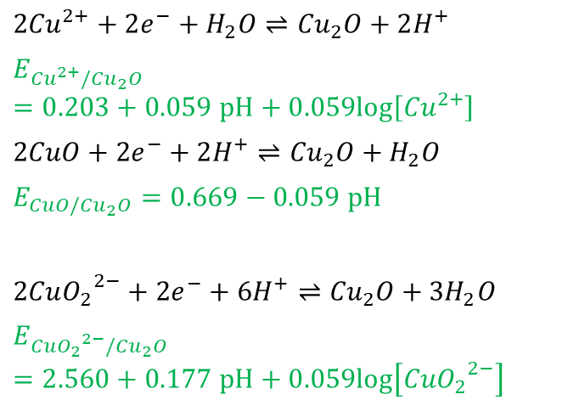


How to build a Pourbaix diagram (E-pH)
Acid-base equilibria
$${Cu}^{2+}⇌CuO⇌Cu{O_{2}}^{2−}$$
Acidity constants
$${Cu}^{+}⇌{Cu}_{2}O$$
Nernst Potentials
$${Cu}^{2+}$$
$$CuO(s)$$
$${{CuO}_{2}}^{2−}$$
$$O_{2}+{4H}^{+}+4e^{−}⇌2H_{2}O$$
Redox Cu^{+II}/Cu^{+I}
$${2Cu}^{2+}+2e^{−}+H_{2}O⇌{Cu}_{2}O+2H^{+}$$
$$E_{{{Cu}^{2+}/Cu}_{2}O}=0.203+0.059 pH+0.059log\left[{Cu}^{2+}\right]$$
$$2CuO+2e^{−}+2H^{+}⇌{Cu}_{2}O+H_{2}O$$
$$E_{{CuO/Cu}_{2}O}=0.669−0.059 pH$$
$$2Cu{O_{2}}^{2−}+2e^{−}+6H^{+}⇌{Cu}_{2}O+{3H}_{2}O$$
$$E_{{{{CuO}_{2}}^{2−}/Cu}_{2}O}=2.560+0.177 pH+0.059log\left[{{CuO}_{2}}^{2−}\right]$$
$${Cu}^{+}$$
${Cu}_{2}O$ (S)
$${2H}^{+}+2e^{−}⇌H_{2}$$
$${Cu}^{0}$$
At 25 °C, $2.303\frac{RT}{F}≈0.059 V$ [Cu]=10⁻⁶ mol/L

Slide 7
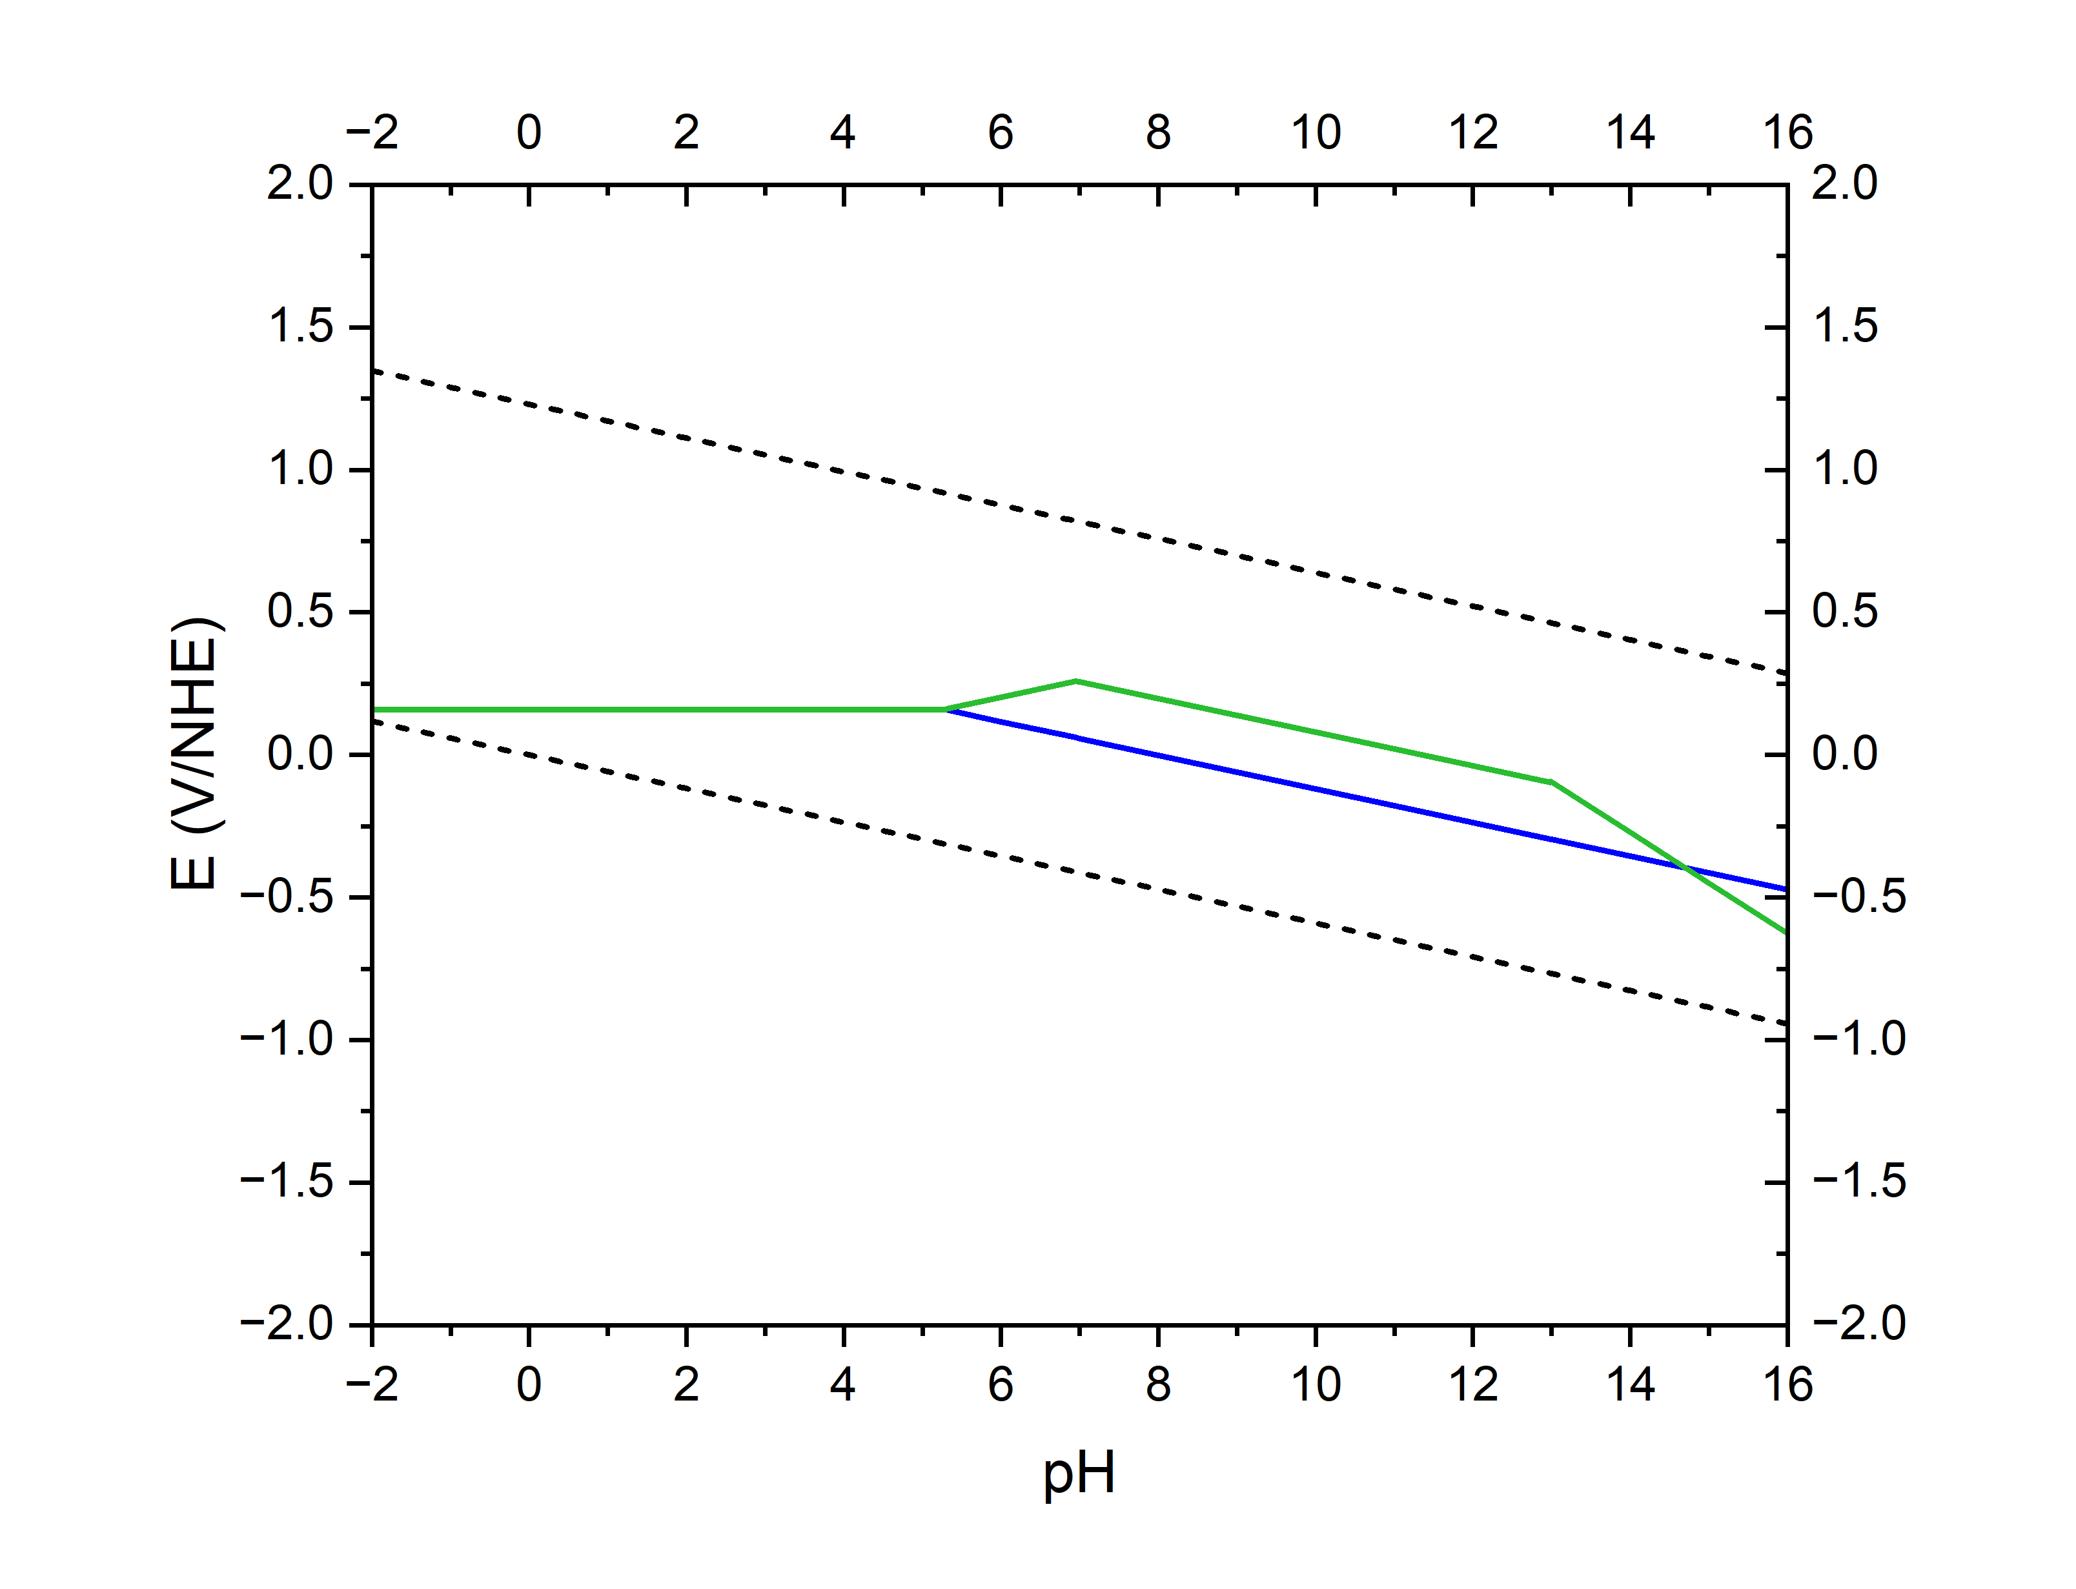
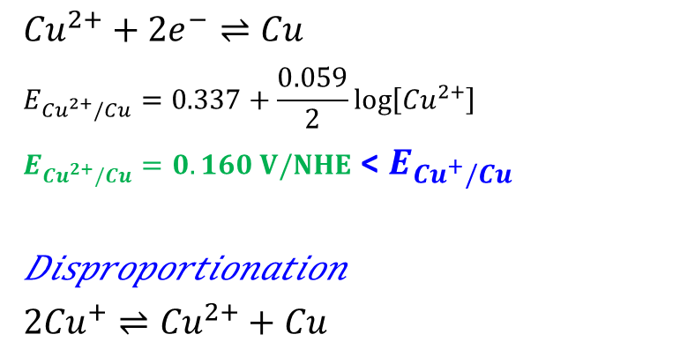
How to build a Pourbaix diagram (E-pH)
Acid-base equilibria
$${Cu}^{2+}⇌CuO⇌Cu{O_{2}}^{2−}$$
Acidity constants
$${Cu}^{+}⇌{Cu}_{2}O$$
Nernst Potentials
$${Cu}^{2+}$$
$$CuO(s)$$
$${{CuO}_{2}}^{2−}$$
$$O_{2}+{4H}^{+}+4e^{−}⇌2H_{2}O$$
Redox Cu^{+II}/Cu⁰
$${Cu}^{2+}+2e^{−}⇌Cu$$
$$E_{{Cu}^{2+}/Cu}=0.337+\frac{0.059}{2}log⁡\left[{Cu}^{2+}\right]$$
$E_{{Cu}^{2+}/Cu}=0.160 V/NHE$ < $E_{{Cu}^{+}/Cu}$
𝐷𝑖𝑠𝑝𝑟𝑜𝑝𝑜𝑟𝑡𝑖𝑜𝑛𝑎𝑡𝑖𝑜𝑛
$${2Cu}^{+}⇌{Cu}^{2+}+Cu$$
${Cu}_{2}O$ (S)
$${2H}^{+}+2e^{−}⇌H_{2}$$
$${Cu}^{0}$$
At 25 °C, $2.303\frac{RT}{F}≈0.059 V$ [Cu]=10⁻⁶ mol/L

Slide 8
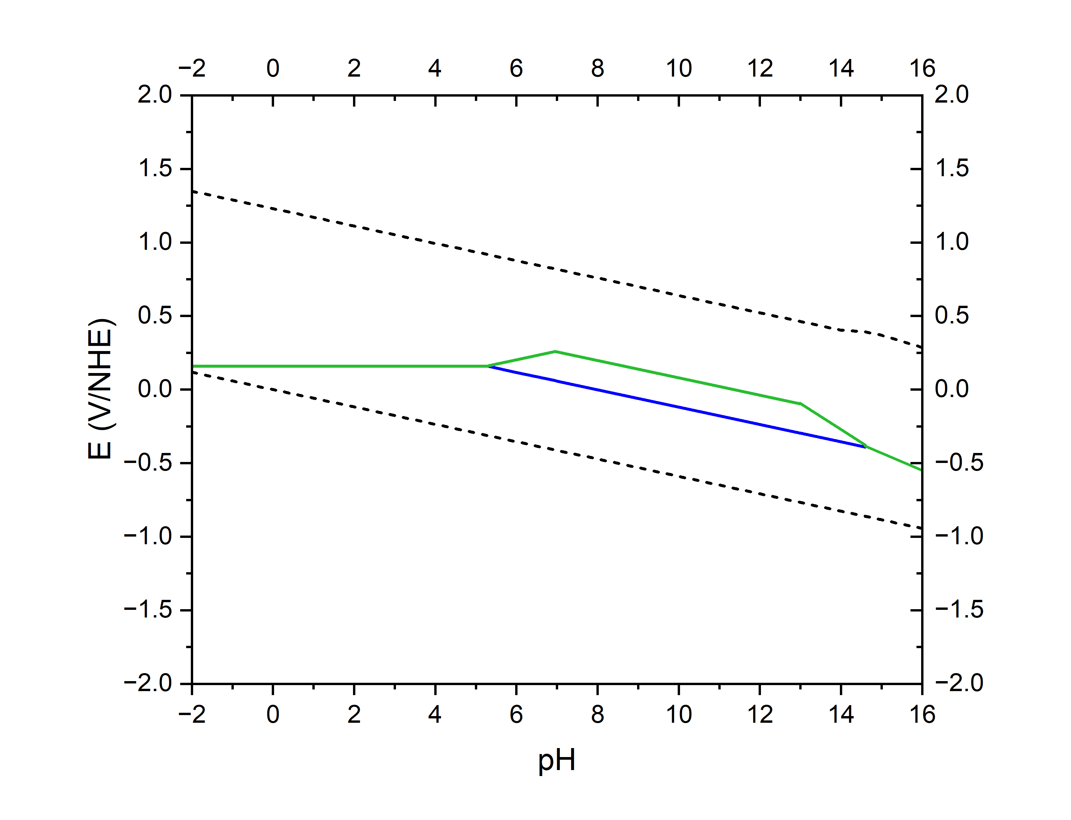
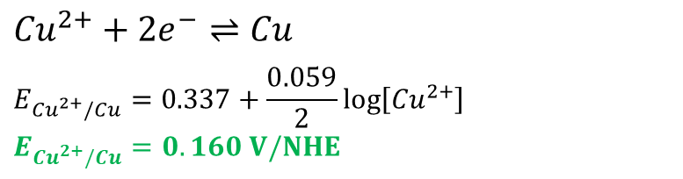
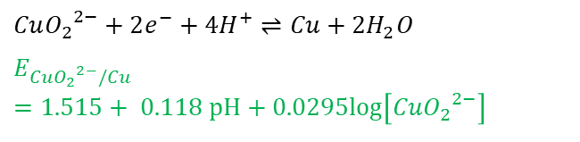
How to build a Pourbaix diagram (E-pH)
Acid-base equilibria
$${Cu}^{2+}⇌CuO⇌Cu{O_{2}}^{2−}$$
Acidity constants
$${Cu}^{+}⇌{Cu}_{2}O$$
Nernst Potentials
$${Cu}^{2+}$$
$$CuO(s)$$
$${{CuO}_{2}}^{2−}$$
$$O_{2}+{4H}^{+}+4e^{−}⇌2H_{2}O$$
Redox Cu^{+II}/Cu⁰
$${Cu}^{2+}+2e^{−}⇌Cu$$
$$E_{{Cu}^{2+}/Cu}=0.337+\frac{0.059}{2}log⁡\left[{Cu}^{2+}\right]$$
$$E_{{Cu}^{2+}/Cu}=0.160 V/NHE$$
${Cu}_{2}O$ (S)
$${2H}^{+}+2e^{−}⇌H_{2}$$
$$Cu{O_{2}}^{2−}+2e^{−}+4H^{+}⇌Cu+{2H}_{2}O$$
$$E_{{{CuO}_{2}}^{2−}/Cu}=1.515+ 0.118 pH+0.0295log\left[{{CuO}_{2}}^{2−}\right]$$
$${Cu}^{0}$$
At 25 °C, $2.303\frac{RT}{F}≈0.059 V$ [Cu]=10⁻⁶ mol/L

Slide 9
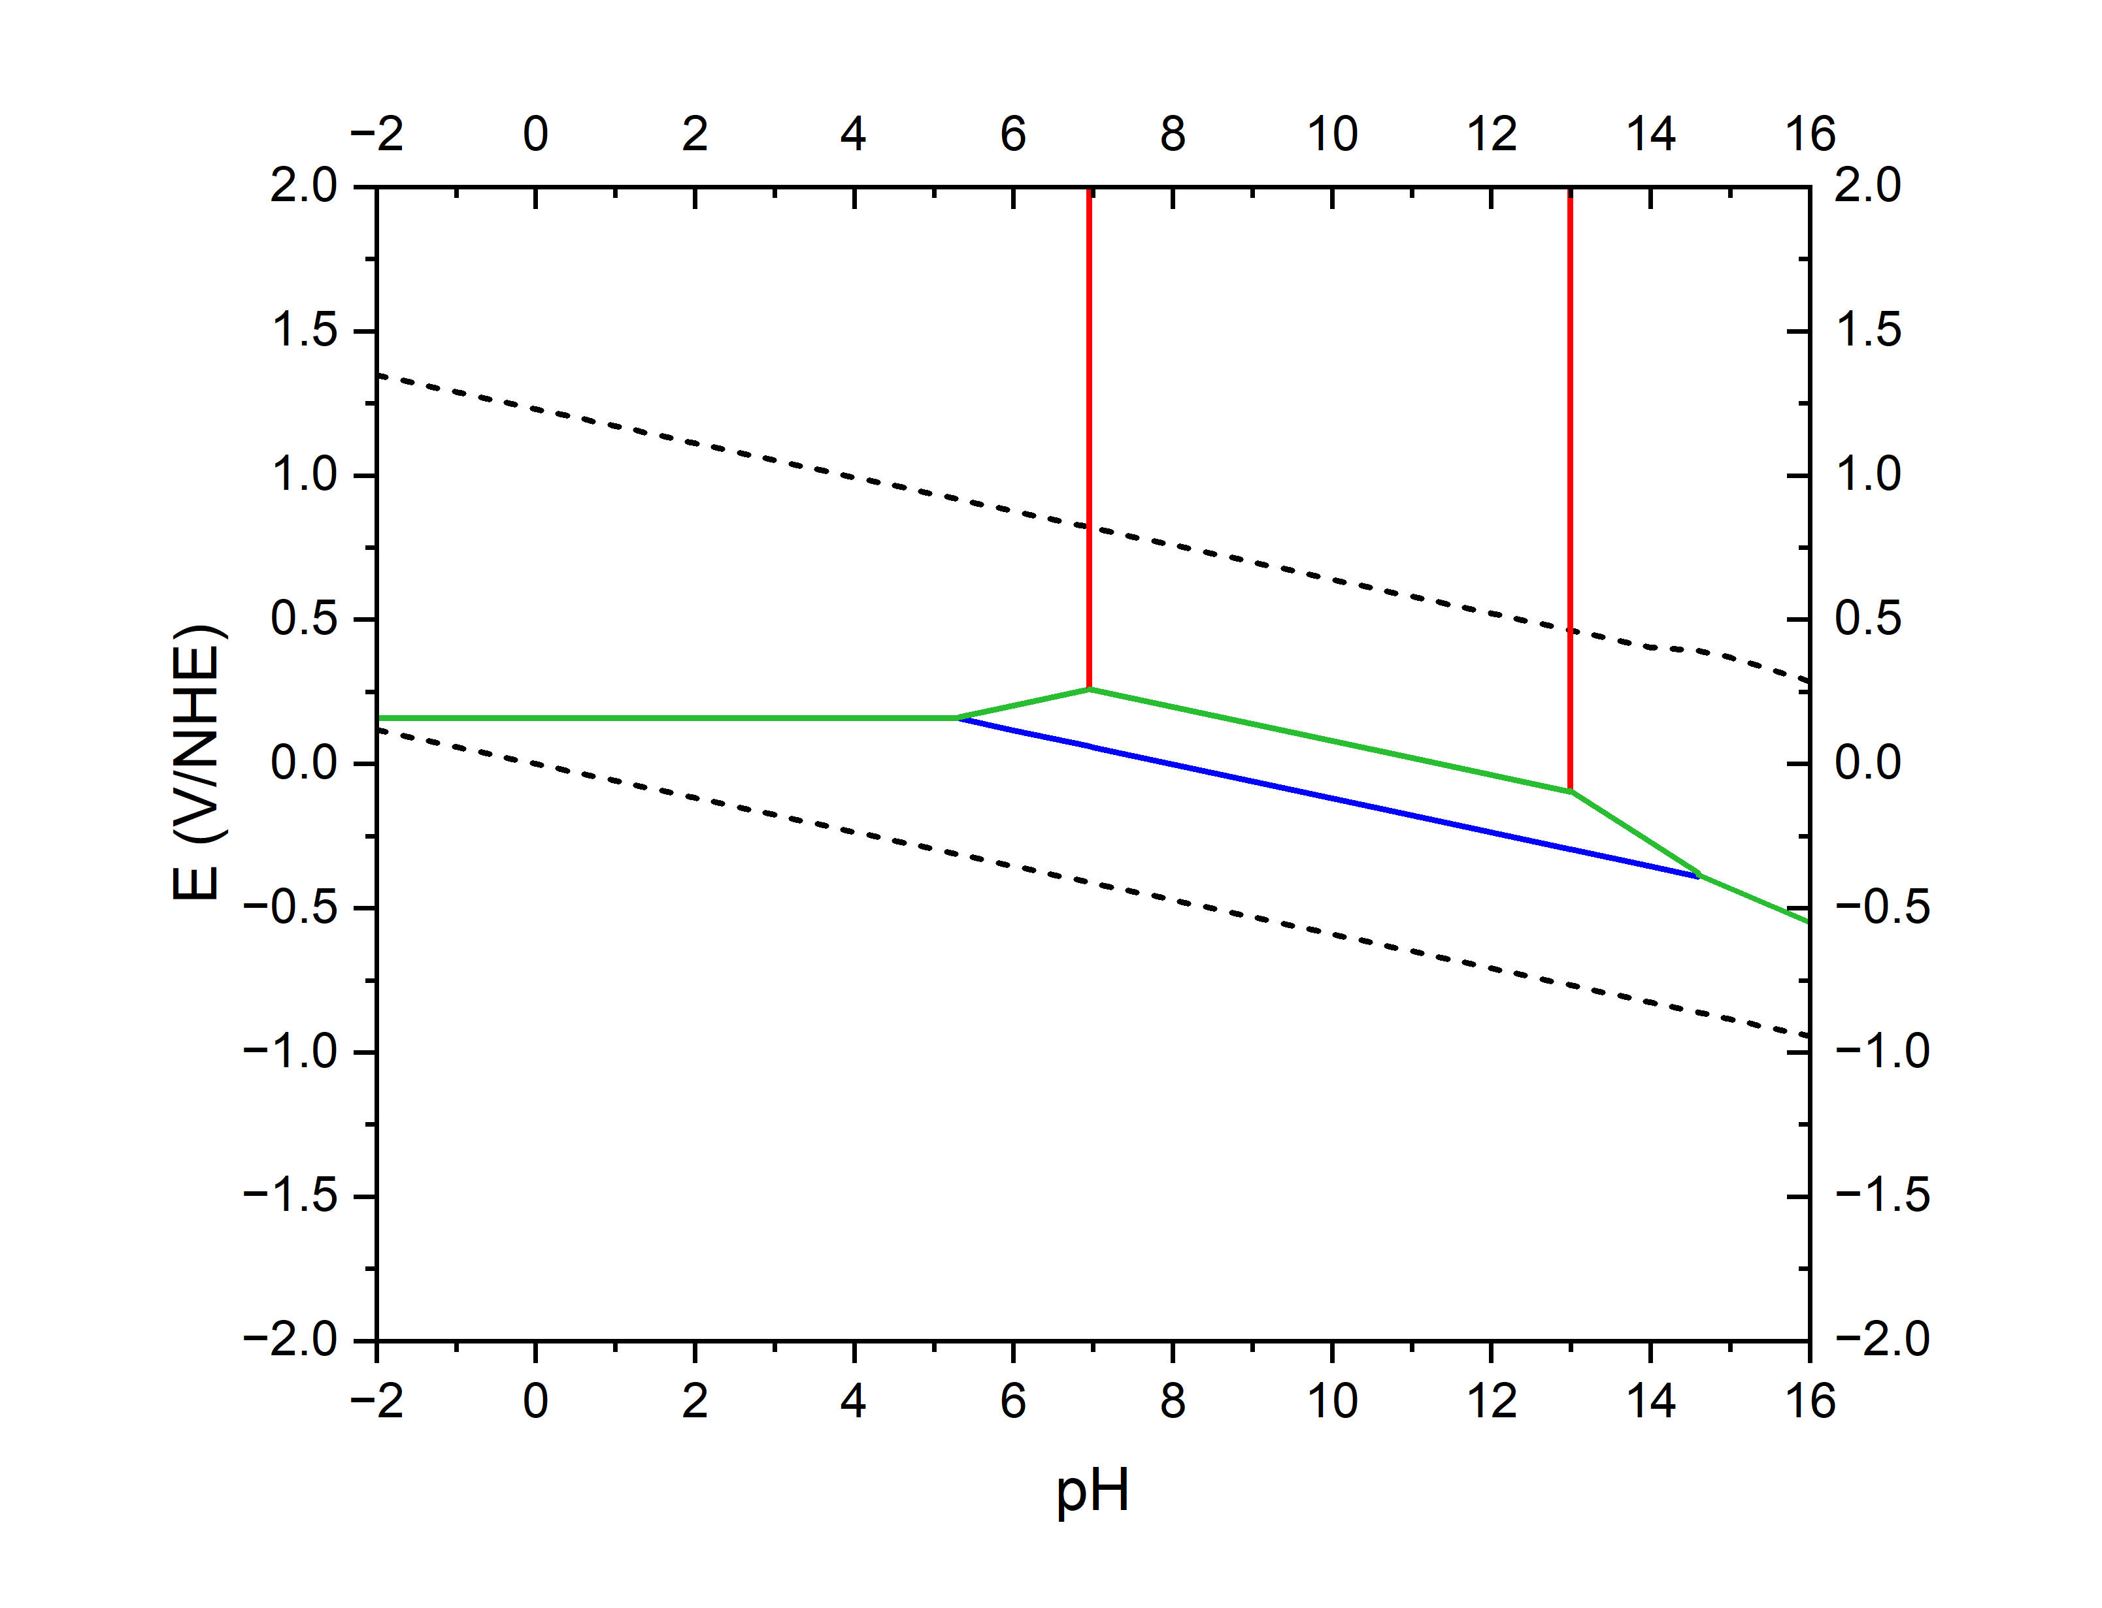



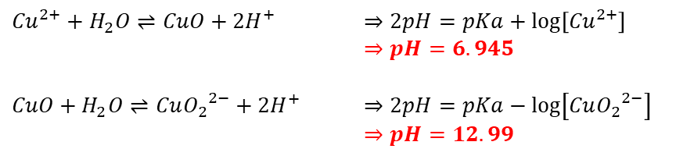

How to build a Pourbaix diagram (E-pH)
Acid-base equilibria
${Cu}^{2+}+H_{2}O⇌CuO+2H^{+}$ $⇒2pH=pKa+log⁡\left[{Cu}^{2+}\right]$
$⇒pH=6.945$
$CuO+H_{2}O⇌Cu{O_{2}}^{2−}+{2H}^{+}$ $⇒2pH=pKa−log⁡\left[{CuO_{2}}^{2−}\right]$
$⇒pH=12.99$
Acidity constants
Nernst Potentials
Corrosion
Passivation
Corrosion
$$CuO(s)$$
$$CuO(s)$$
$${{CuO}_{2}}^{2−}$$
$${Cu}^{2+}$$
$${{CuO}_{2}}^{2−}$$
$${Cu}^{2+}$$
$$O_{2}+{4H}^{+}+4e^{−}⇌2H_{2}O$$
$${Cu}^{+II}: {Cu}^{2+}⇌CuO⇌Cu{O_{2}}^{2−}$$
$$⇌$$
${Cu}_{2}O$ (S)
Immunity
$${2H}^{+}+2e^{−}⇌H_{2}$$
$${Cu}^{+I}: {Cu}^{+}⇌{Cu}_{2}O$$
$$⇌$$
$${Cu}^{0}$$
$${Cu}^{0}$$
$${Cu}^{0}$$
At 25 °C, $2.303\frac{RT}{F}≈0.059 V$ [Cu]=10⁻⁶ mol/L

Slide 10
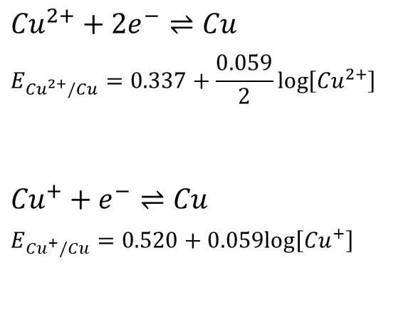
How to build a Pourbaix diagram (E-pH)
Acid-base equilibria
$${Cu}^{2+}⇌CuO⇌Cu{O_{2}}^{2−}$$
Acidity constants
$${Cu}^{+}⇌{Cu}_{2}O$$
Nernst Potentials
Redox
$${Cu}^{2+}+2e^{−}⇌Cu$$
$$E_{{Cu}^{2+}/Cu}=0.337+\frac{0.059}{2}log⁡\left[{Cu}^{2+}\right]$$
$$E_{{Cu}^{2+}/Cu}=0.160 V/NHE$$
$${Cu}^{+}+e^{−}⇌Cu$$
$$E_{{Cu}^{+}/Cu}=0.520+0.059log⁡\left[{Cu}^{+}\right]$$
$E_{{Cu}^{+}/Cu}=0.166 V/NHE$ > $E_{{Cu}^{2+}/Cu}$
At 25 °C, $2.303\frac{RT}{F}≈0.059 V$ [Cu]=10⁻⁶ mol/L

Slide 11
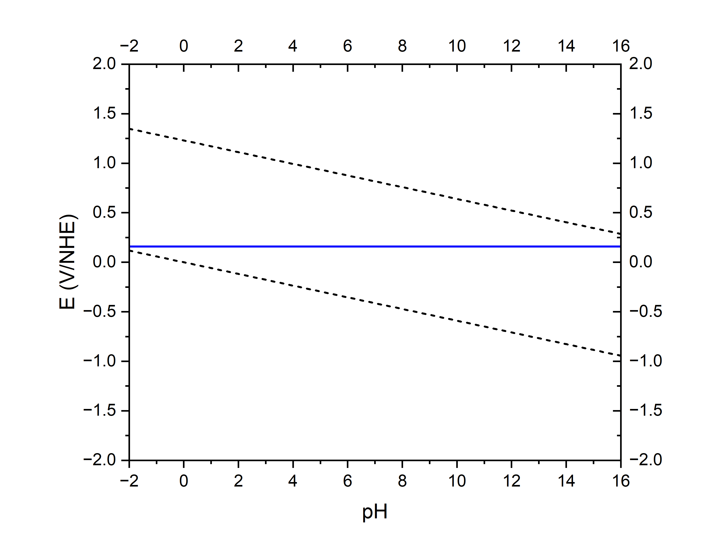
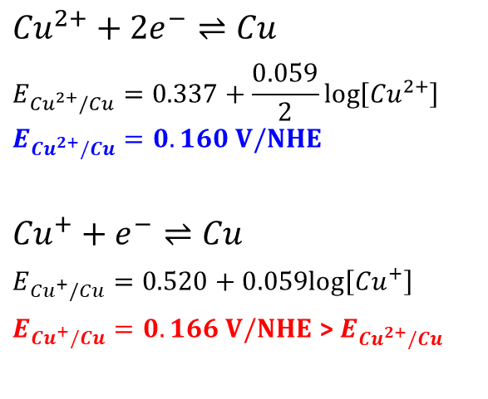
How to build a Pourbaix diagram (E-pH)
Acid-base equilibria
$${Cu}^{2+}⇌CuO⇌Cu{O_{2}}^{2−}$$
Acidity constants
$${Cu}^{+}⇌{Cu}_{2}O$$
Nernst Potentials
$${Cu}^{2+}$$
Redox
$${Cu}^{2+}+2e^{−}⇌Cu$$
$$E_{{Cu}^{2+}/Cu}=0.337+\frac{0.059}{2}log⁡\left[{Cu}^{2+}\right]$$
$$E_{{Cu}^{2+}/Cu}=0.160 V/NHE$$
$${Cu}^{+}+e^{−}⇌Cu$$
$$E_{{Cu}^{+}/Cu}=0.520+0.059log⁡\left[{Cu}^{+}\right]$$
$E_{{Cu}^{+}/Cu}=0.166 V/NHE$ > $E_{{Cu}^{2+}/Cu}$
$${Cu}^{0}$$
At 25 °C, $2.303\frac{RT}{F}≈0.059 V$ [Cu]=10⁻⁶ mol/L

Slide 12
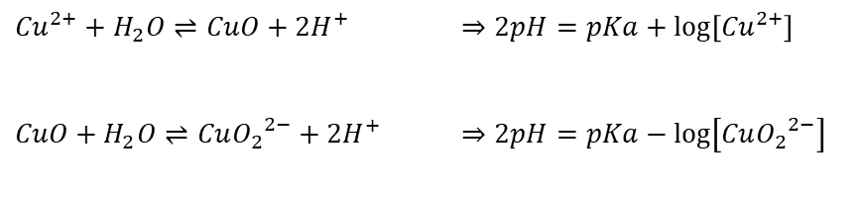
How to build a Pourbaix diagram (E-pH)
Acid-base equilibria
${Cu}^{2+}+H_{2}O⇌CuO+2H^{+}$ $⇒2pH=pKa+log⁡\left[{Cu}^{2+}\right]$
$⇒pH=6.945$
$CuO+H_{2}O⇌Cu{O_{2}}^{2−}+{2H}^{+}$ $⇒2pH=pKa−log⁡\left[{CuO_{2}}^{2−}\right]$
$⇒pH=12.99$
Acidity constants
Nernst Potentials
$${Cu}^{2+}$$
Redox
$${Cu}^{2+}+2e^{−}⇌Cu$$
$$E_{{Cu}^{2+}/Cu}=0.337+\frac{0.059}{2}log⁡\left[{Cu}^{2+}\right]$$
$$E_{{Cu}^{2+}/Cu}=0.160 V/NHE$$
$${Cu}^{+}+e^{−}⇌Cu$$
$$E_{{Cu}^{+}/Cu}=0.520+0.059log⁡\left[{Cu}^{+}\right]$$
$E_{{Cu}^{+}/Cu}=0.166 V/NHE$ > $E_{{Cu}^{2+}/Cu}$
$${Cu}^{0}$$
At 25 °C, $2.303\frac{RT}{F}≈0.059 V$ [Cu]=10⁻⁶ mol/L

Slide 13
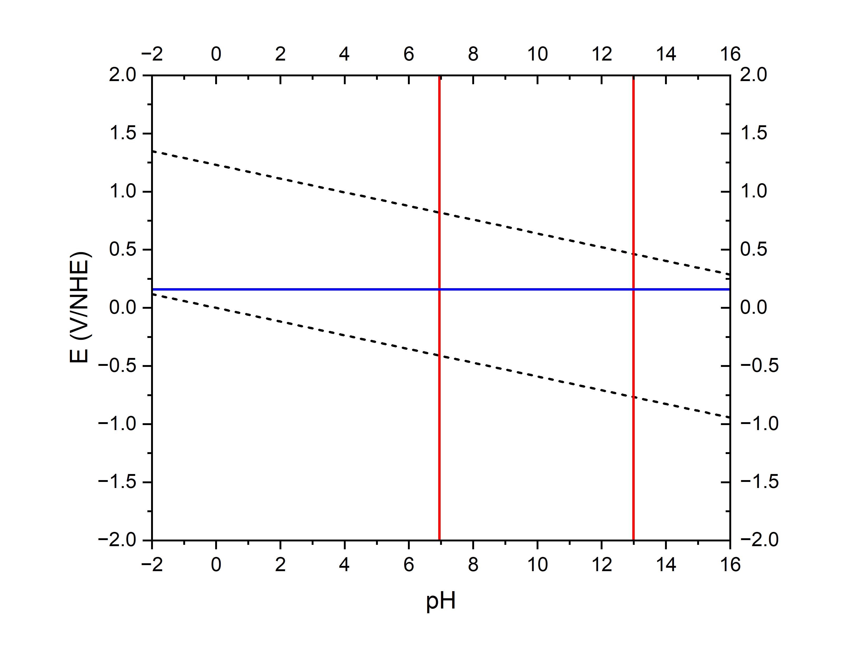
How to build a Pourbaix diagram (E-pH)
Acid-base equilibria
${Cu}^{2+}+H_{2}O⇌CuO+2H^{+}$ $⇒2pH=pKa+log⁡\left[{Cu}^{2+}\right]$
$⇒pH=6.945$
$CuO+H_{2}O⇌Cu{O_{2}}^{2−}+{2H}^{+}$ $⇒2pH=pKa−log⁡\left[{CuO_{2}}^{2−}\right]$
$⇒pH=12.99$
Acidity constants
Nernst Potentials
$${Cu}^{2+}$$
$$CuO(s)$$
$${{CuO}_{2}}^{2−}$$
Redox
$${Cu}^{2+}+2e^{−}⇌Cu$$
$$E_{{Cu}^{2+}/Cu}=0.337+\frac{0.059}{2}log⁡\left[{Cu}^{2+}\right]$$
$$E_{{Cu}^{2+}/Cu}=0.160 V/NHE$$
$${Cu}^{+}+e^{−}⇌Cu$$
$$E_{{Cu}^{+}/Cu}=0.520+0.059log⁡\left[{Cu}^{+}\right]$$
$E_{{Cu}^{+}/Cu}=0.166 V/NHE$ > $E_{{Cu}^{2+}/Cu}$
$${Cu}^{0}$$
At 25 °C, $2.303\frac{RT}{F}≈0.059 V$ [Cu]=10⁻⁶ mol/L

Slide 14
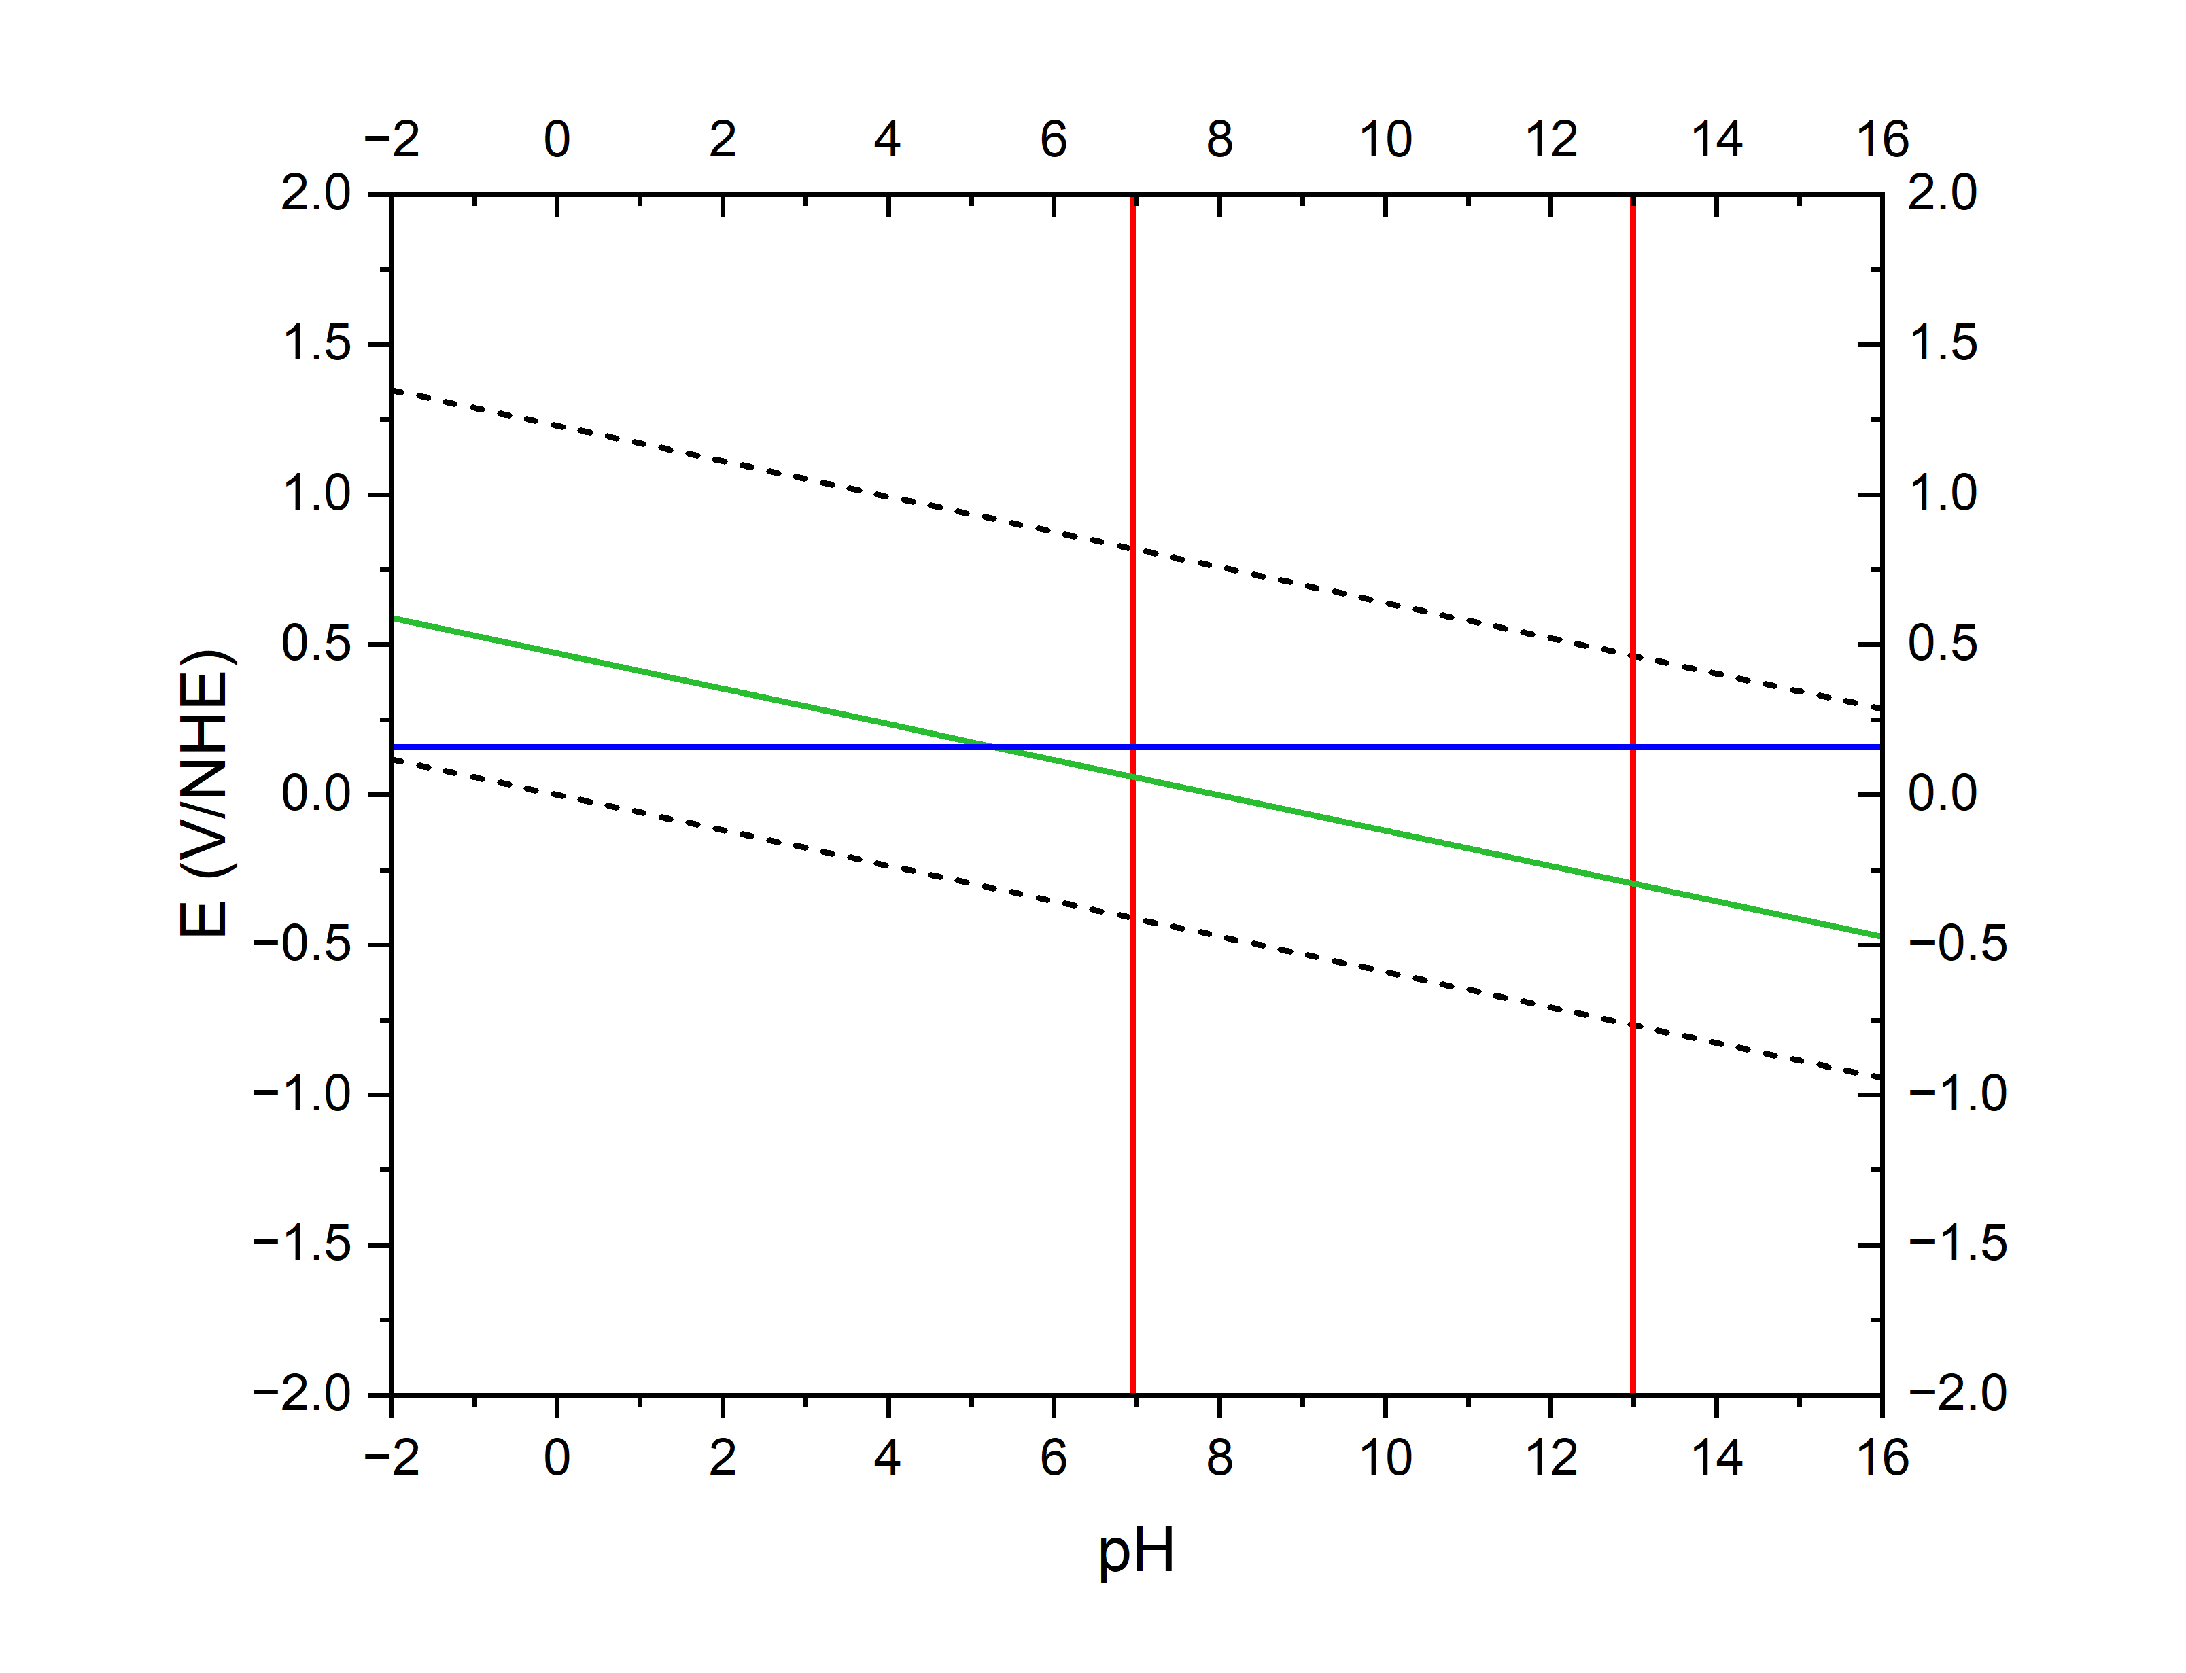

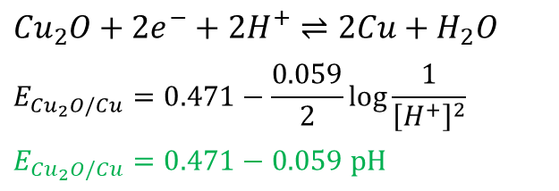
How to build a Pourbaix diagram (E-pH)
Acid-base equilibria
${Cu}^{2+}+H_{2}O⇌CuO+2H^{+}$ $⇒2pH=pKa+log⁡\left[{Cu}^{2+}\right]$
$⇒pH=6.945$
$CuO+H_{2}O⇌Cu{O_{2}}^{2−}+{2H}^{+}$ $⇒2pH=pKa−log⁡\left[{CuO_{2}}^{2−}\right]$
$⇒pH=12.99$
Acidity constants
Nernst Potentials
$${Cu}^{2+}$$
$$CuO(s)$$
$${{CuO}_{2}}^{2−}$$
Redox
$${Cu}_{2}O+2e^{−}+2H^{+}⇌2Cu+H_{2}O$$
$$E_{{Cu}_{2}O/Cu}=0.471−\frac{0.059}{2}log\frac{1}{{\left[H^{+}\right]}^{2}}$$
$$E_{{Cu}_{2}O/Cu}=0.471−0.059 pH$$
${Cu}_{2}O$ (S)
$${Cu}^{0}$$
At 25 °C, $2.303\frac{RT}{F}≈0.059 V$ [Cu]=10⁻⁶ mol/L

Slide 15
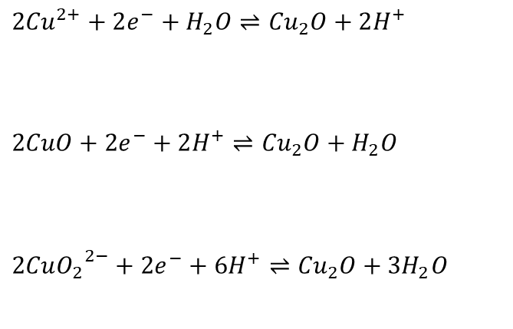
How to build a Pourbaix diagram (E-pH)
Acid-base equilibria
${Cu}^{2+}+H_{2}O⇌CuO+2H^{+}$ $⇒2pH=pKa+log⁡\left[{Cu}^{2+}\right]$
$⇒pH=6.945$
$CuO+H_{2}O⇌Cu{O_{2}}^{2−}+{2H}^{+}$ $⇒2pH=pKa−log⁡\left[{CuO_{2}}^{2−}\right]$
$⇒pH=12.99$
Acidity constants
Nernst Potentials
$${Cu}^{2+}$$
$$CuO(s)$$
$${{CuO}_{2}}^{2−}$$
Redox
$${2Cu}^{2+}+2e^{−}+H_{2}O⇌{Cu}_{2}O+2H^{+}$$
$$2CuO+2e^{−}+2H^{+}⇌{Cu}_{2}O+H_{2}O$$
$$2Cu{O_{2}}^{2−}+2e^{−}+6H^{+}⇌{Cu}_{2}O+{3H}_{2}O$$
${Cu}_{2}O$ (S)
$${Cu}^{0}$$
At 25 °C, $2.303\frac{RT}{F}≈0.059 V$ [Cu]=10⁻⁶ mol/L

Slide 16
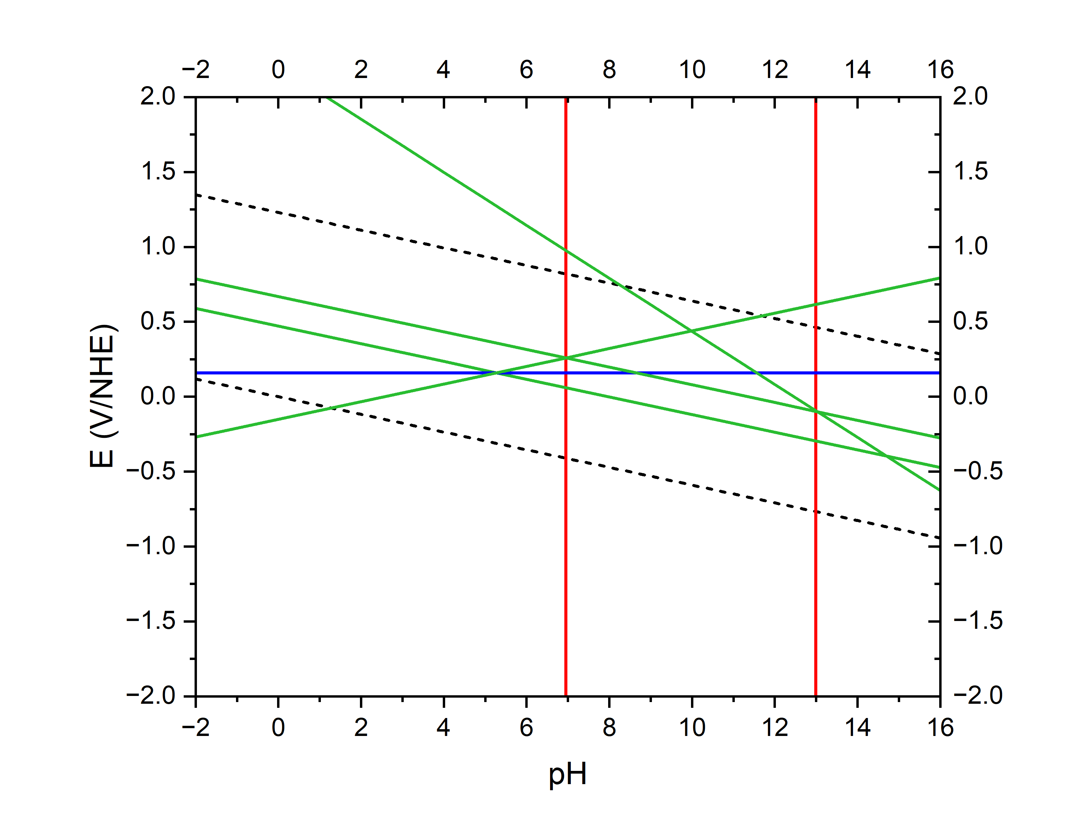
How to build a Pourbaix diagram (E-pH)
Acid-base equilibria
${Cu}^{2+}+H_{2}O⇌CuO+2H^{+}$ $⇒2pH=pKa+log⁡\left[{Cu}^{2+}\right]$
$⇒pH=6.945$
$CuO+H_{2}O⇌Cu{O_{2}}^{2−}+{2H}^{+}$ $⇒2pH=pKa−log⁡\left[{CuO_{2}}^{2−}\right]$
$⇒pH=12.99$
Acidity constants
Nernst Potentials
$${Cu}^{2+}$$
$$CuO(s)$$
$${{CuO}_{2}}^{2−}$$
Redox
$${2Cu}^{2+}+2e^{−}+H_{2}O⇌{Cu}_{2}O+2H^{+}$$
$$E_{{{Cu}^{2+}/Cu}_{2}O}=0.203+0.059 pH+0.059log\left[{Cu}^{2+}\right]$$
$$2CuO+2e^{−}+2H^{+}⇌{Cu}_{2}O+H_{2}O$$
$$E_{{CuO/Cu}_{2}O}=0.669−0.059 pH$$
$$2Cu{O_{2}}^{2−}+2e^{−}+6H^{+}⇌{Cu}_{2}O+{3H}_{2}O$$
$$E_{{{{CuO}_{2}}^{2−}/Cu}_{2}O}=2.560+0.177 pH+0.059log\left[{{CuO}_{2}}^{2−}\right]$$
${Cu}_{2}O$ (S)
$${Cu}^{0}$$
At 25 °C, $2.303\frac{RT}{F}≈0.059 V$ [Cu]=10⁻⁶ mol/L

Slide 17
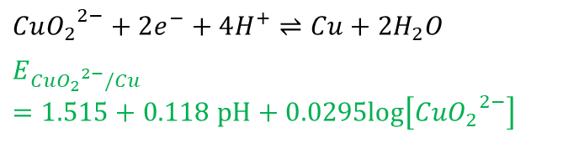
How to build a Pourbaix diagram (E-pH)
Acid-base equilibria
${Cu}^{2+}+H_{2}O⇌CuO+2H^{+}$ $⇒2pH=pKa+log⁡\left[{Cu}^{2+}\right]$
$⇒pH=6.945$
$CuO+H_{2}O⇌Cu{O_{2}}^{2−}+{2H}^{+}$ $⇒2pH=pKa−log⁡\left[{CuO_{2}}^{2−}\right]$
$⇒pH=12.99$
Acidity constants
Nernst Potentials
$${Cu}^{2+}$$
$$CuO(s)$$
$${{CuO}_{2}}^{2−}$$
Redox
$$Cu{O_{2}}^{2−}+2e^{−}+4H^{+}⇌Cu+{2H}_{2}O$$
$$E_{{{CuO}_{2}}^{2−}/Cu}=1.515+0.118 pH+0.0295log\left[{{CuO}_{2}}^{2−}\right]$$
${Cu}_{2}O$ (S)
$${Cu}^{0}$$
At 25 °C, $2.303\frac{RT}{F}≈0.059 V$ [Cu]=10⁻⁶ mol/L

Slide 18





How to build a Pourbaix diagram (E-pH)
Acid-base equilibria
${Cu}^{2+}+H_{2}O⇌CuO+2H^{+}$ $⇒2pH=pKa+log⁡\left[{Cu}^{2+}\right]$
$⇒pH=6.945$
$CuO+H_{2}O⇌Cu{O_{2}}^{2−}+{2H}^{+}$ $⇒2pH=pKa−log⁡\left[{CuO_{2}}^{2−}\right]$
$⇒pH=12.99$
Acidity constants
Nernst Potentials
Corrosion
Passivation
Corrosion
$${Cu}^{2+}$$
$$CuO(s)$$
$${{CuO}_{2}}^{2−}$$
Redox
$$Cu{O_{2}}^{2−}+2e^{−}+4H^{+}⇌Cu+{2H}_{2}O$$
$$E_{{{CuO}_{2}}^{2−}/Cu}=1.515+0.118 pH+0.0295log\left[{{CuO}_{2}}^{2−}\right]$$
Immunity
${Cu}_{2}O$ (S)
$${Cu}^{0}$$
At 25 °C, $2.303\frac{RT}{F}≈0.059 V$ [Cu]=10⁻⁶ mol/L

Slide 19
Exercise1: Pourbaix diagram
You want to electrodeposit bismuth from an aqueous electrolyte and you want to choose the ideal pH.
You decide to refer to the E-pH thermodynamic equilibriums found in Pourbaix diagram.
You find the Pourbaix diagram for Bi³⁺ in pure water at ambient conditions:
4
5
3
1
2
6
What represent the vertical, horizontal, and diagonal lines. Why are their duplicated lines?
Vertical: acid-base reactions which do not depend on the potential without electron transfer
Horizontal: redox reaction which do involve neither H⁺ nor OH⁻
Diagonal: redox reactions in which hydroxide or hydrogen are involved
Line duplicates show the effect of Bi³⁺ concentration

Slide 20
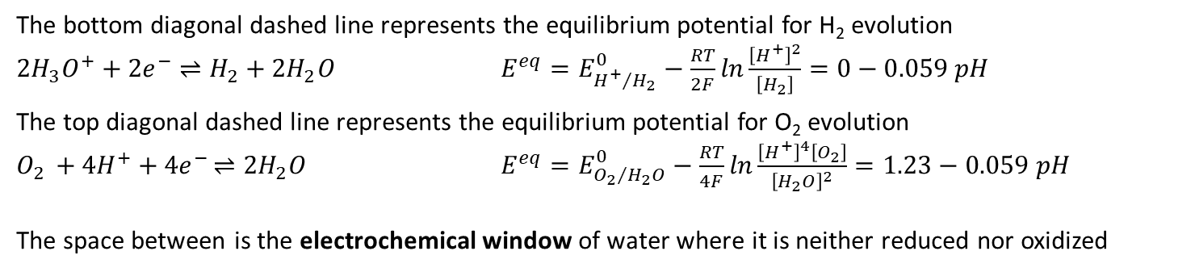
Exercise1: Pourbaix diagram
You want to electrodeposit bismuth from an aqueous electrolyte and you want to choose the ideal pH.
You decide to refer to the E-pH thermodynamic equilibriums found in Pourbaix diagram.
You find the Pourbaix diagram for Bi³⁺ in pure water at ambient conditions:
4
5
3
1
2
6
2) What are the diagonal dashed lines? Write the reactions? Name the space defined between them.
The bottom diagonal dashed line represents the equilibrium potential for H₂ evolution
${2H}_{3}O^{+} {+ 2e}^{−} ⇌H_{2}+{2H}_{2}O$ $E^{eq}=E_{{H^{+}}/{H_{2}}}^{0}−\frac{RT}{2F}ln\frac{{\left[H^{+}\right]}^{2}}{\left[H_{2}\right]}=0−0.059 pH$
The top diagonal dashed line represents the equilibrium potential for O₂ evolution
$O_{2}{ + 4H^{+}+4e}^{−}⇌{2H}_{2}O$ $E^{eq}=E_{{O_{2}}/{H_{2}O}}^{0}−\frac{RT}{4F}ln\frac{{\left[H^{+}\right]}^{4}\left[O_{2}\right]}{{\left[H_{2}O\right]}^{2}}=1.23−0.059 pH$
The space between is the electrochemical window of water where it is neither reduced nor oxidized

Slide 21
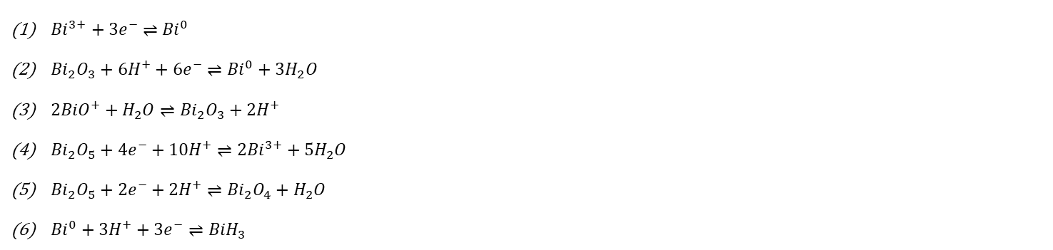
Exercise1: Pourbaix diagram
You want to electrodeposit bismuth from an aqueous electrolyte and you want to choose the ideal pH.
You decide to refer to the E-pH thermodynamic equilibriums found in Pourbaix diagram.
You find the Pourbaix diagram for Bi³⁺ in pure water at ambient conditions:
4
5
3
1
2
6
3) Write the reactions that occur at the transitions 1, 2, 3, 4, 5, and 6
${Bi}^{3+} {+ 3e}^{−} ⇌{Bi}^{0}$
${Bi}_{2}O_{3}+{6H}^{+}+{6e}^{−}⇌{Bi}^{0}+3H_{2}O$
${2BiO}^{+}+H_{2}O⇌{Bi}_{2}O_{3}+{2H}^{+}$
${Bi}_{2}O_{5}+{4e}^{−}+10H^{+}⇌{2Bi}^{3+}+5H_{2}O$
${Bi}_{2}O_{5}+{2e}^{−}+2H^{+}⇌{Bi}_{2}O_{4}+H_{2}O$
${Bi}^{0}+{3H}^{+}+{3e}^{−}⇌{BiH}_{3}$

Slide 22
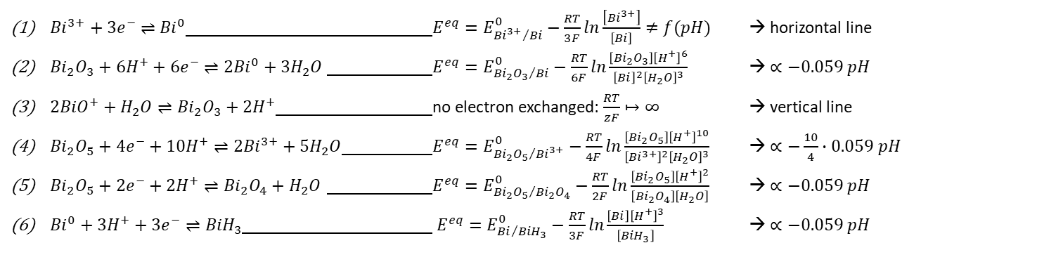
Exercise1: Pourbaix diagram
You want to electrodeposit bismuth from an aqueous electrolyte and you want to choose the ideal pH.
You decide to refer to the E-pH thermodynamic equilibriums found in Pourbaix diagram.
You find the Pourbaix diagram for Bi³⁺ in pure water at ambient conditions:
4
5
3
1
2
Apply the Nernst equation !!!
The activity of solvents, solids, and gases are taken as 1
6
4) Determine their slope.
${Bi}^{3+} {+ 3e}^{−} ⇌{Bi}^{0}$ $E^{eq}=E_{{{Bi}^{3+}}/{Bi}}^{0}−\frac{RT}{3F}ln\frac{\left[{Bi}^{3+}\right]}{\left[Bi\right]}≠f(pH)$ → horizontal line
${Bi}_{2}O_{3}+{6H}^{+}+{6e}^{−}⇌{2Bi}^{0}+3H_{2}O$ $E^{eq}=E_{{{Bi}_{2}O_{3}}/{Bi}}^{0}−\frac{RT}{6F}ln\frac{\left[{Bi}_{2}O_{3}\right]{\left[H^{+}\right]}^{6}}{{\left[Bi\right]}^{2}{\left[H_{2}O\right]}^{3}}$ → $∝−0.059 pH$
${2BiO}^{+}+H_{2}O⇌{Bi}_{2}O_{3}+{2H}^{+}$ no electron exchanged: $\frac{RT}{zF}↦∞$ → vertical line
${Bi}_{2}O_{5}+{4e}^{−}+10H^{+}⇌{2Bi}^{3+}+5H_{2}O$ $E^{eq}=E_{{{Bi}_{2}O_{5}}/{{Bi}^{3+}}}^{0}−\frac{RT}{4F}ln\frac{\left[{Bi}_{2}O_{5}\right]{\left[H^{+}\right]}^{10}}{{\left[{Bi}^{3+}\right]}^{2}{\left[H_{2}O\right]}^{3}}$ → $∝−\frac{10}{4}∙0.059 pH$
${Bi}_{2}O_{5}+{2e}^{−}+2H^{+}⇌{Bi}_{2}O_{4}+H_{2}O$ $E^{eq}=E_{{{Bi}_{2}O_{5}}/{{Bi}_{2}O_{4}}}^{0}−\frac{RT}{2F}ln\frac{\left[{Bi}_{2}O_{5}\right]{\left[H^{+}\right]}^{2}}{\left[{Bi}_{2}O_{4}\right]\left[H_{2}O\right]}$ → $∝−0.059 pH$
${Bi}^{0}+{3H}^{+}+{3e}^{−}⇌{BiH}_{3}$ $E^{eq}=E_{{Bi}/{{BiH}_{3}}}^{0}−\frac{RT}{3F}ln\frac{\left[Bi\right]{\left[H^{+}\right]}^{3}}{\left[{BiH}_{3}\right]}$ → $∝−0.059 pH$

Slide 23
Exercise1: Pourbaix diagram
5) From the Pourbaix diagram, propose boundary conditions on E, pH and [Bi³⁺] for the electrodeposition of Bi⁰
4
5
The direct reduction of Bi³⁺ is prefered → no local pH change
3
1
2
6

Slide 24
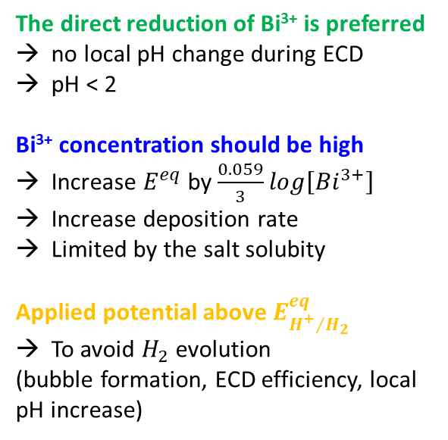
Exercise1: Pourbaix diagram
5) From the Pourbaix diagram, propose boundary conditions on E, pH and [Bi³⁺] for the electrodeposition of Bi⁰
4
5
3
The direct reduction of Bi³⁺ is preferred
no local pH change during ECD
pH < 2
Bi³⁺ concentration should be high
Increase $E^{eq}$ by $\frac{0.059}{3}log\left[{Bi}^{3+}\right]$
Increase deposition rate
Limited by the salt solubity
Applied potential above $E_{{H^{+}}/{H_{2}}}^{eq}$
To avoid $H_{2}$ evolution
(bubble formation, ECD efficiency, local pH increase)
1
2
6

Slide 25
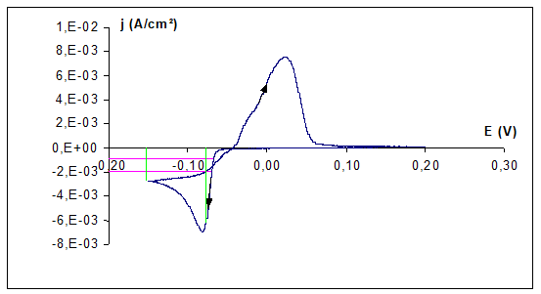
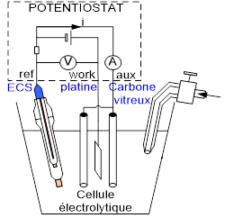
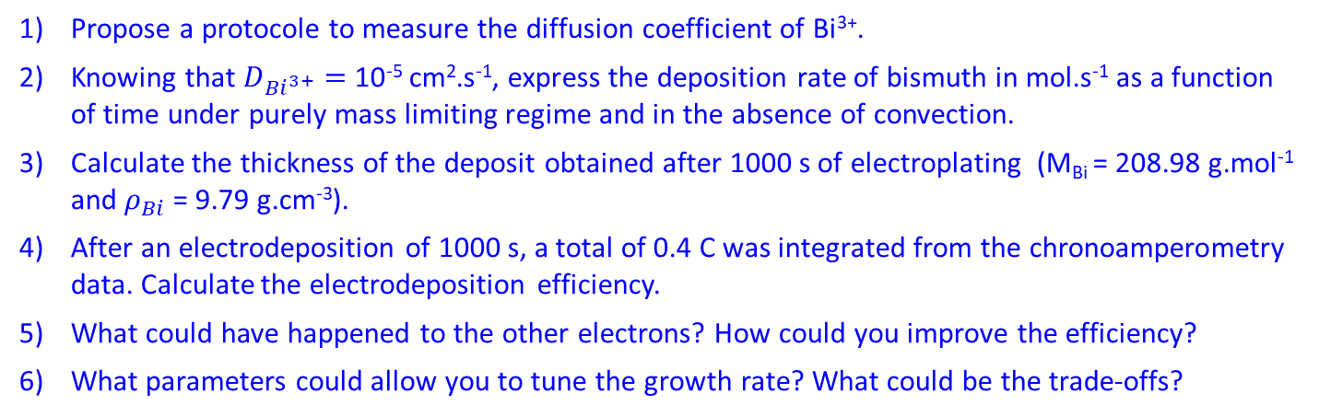
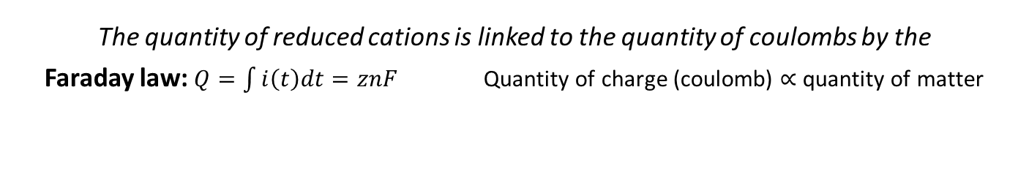
Exercise2: electrodeposition rate and current efficiency
The quantity of reduced cations is linked to the quantity of coulombs by the
Faraday law: $Q=\int{i\left(t\right)dt=znF}$ Quantity of charge (coulomb) $∝$ quantity of matter
Faraday constant $F=q𝒩_{A}=96485 C.{mol}^{−1}$
Bismuth is electrodeposited from a degased aqueous electrolyte ([Bi³⁺] = 10⁻² mol.L⁻¹, [HNO₃] = 1 M) on an 1 cm² working electrode at a sufficiently large overpotential
Argon
Propose a protocole to measure the diffusion coefficient of Bi³⁺.
Knowing that $D_{{Bi}^{3+}}=$ 10⁻⁵ cm².s⁻¹, express the deposition rate of bismuth in mol.s⁻¹ as a function of time under purely mass limiting regime and in the absence of convection.
Calculate the thickness of the deposit obtained after 1000 s of electroplating (M_{Bi} = 208.98 g.mol⁻¹ and $ρ_{Bi}$ = 9.79 g.cm⁻³).
After an electrodeposition of 1000 s, a total of 0.4 C was integrated from the chronoamperometry data. Calculate the electrodeposition efficiency.
What could have happened to the other electrons? How could you improve the efficiency?
What parameters could allow you to tune the growth rate? What could be the trade-offs?

Slide 26
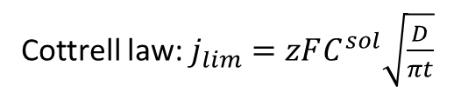

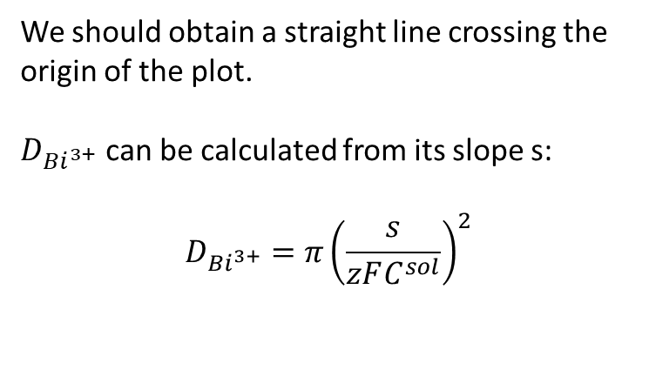
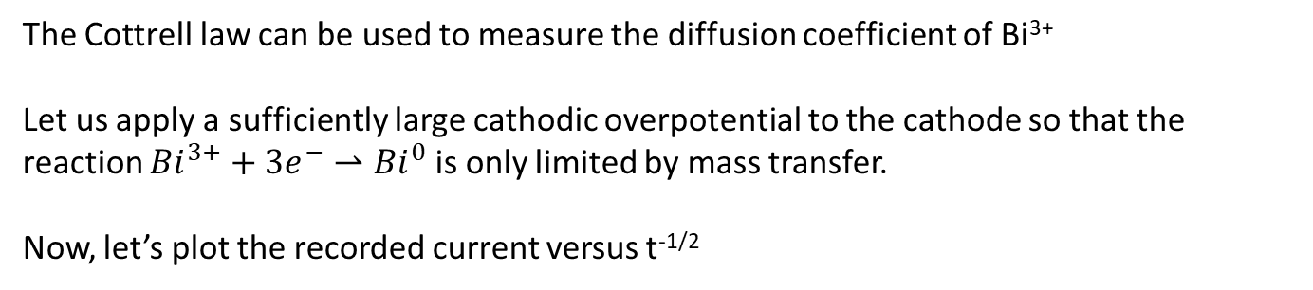
Exercise2: electrodeposition rate and current efficiency
Propose a protocole to measure the diffusion coefficient of Bi³⁺.
The Cottrell law can be used to measure the diffusion coefficient of Bi³⁺
Let us apply a sufficiently large cathodic overpotential to the cathode so that the reaction ${Bi}^{3+}+3e^{−}⇀{Bi}^{0}$ is only limited by mass transfer.
Now, let’s plot the recorded current versus t^{-1/2}
i
t^{-1/2}
We should obtain a straight line crossing the origin of the plot.
$D_{{Bi}^{3+}}$ can be calculated from its slope s:
$$D_{{Bi}^{3+}}=π{\left(\frac{s}{zFC^{sol}}\right)}^{2}$$
$$AzFC^{sol}\sqrt{\frac{D}{π}}$$
Cottrell law: $j_{lim}=zFC^{sol}\sqrt{\frac{D}{πt}}$

Slide 27
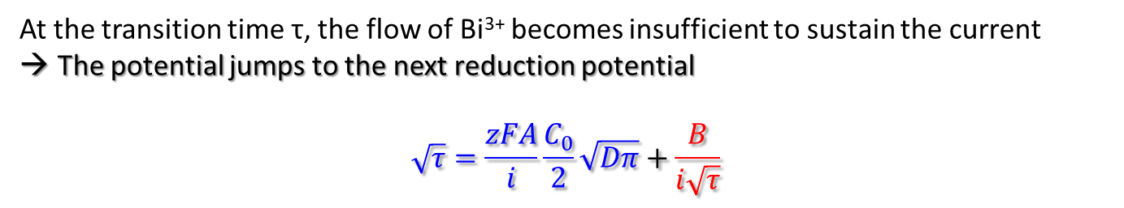


Exercise2: electrodeposition rate and current efficiency
Propose a protocole to measure the diffusion coefficient of Bi³⁺.
In electrochemical deposition, no steady state is reached !!!
A better protocole is the Sand-Bard method that corrects surface modifications
Potential
time
Surface effects (EDL, contaminants…)
$${Bi}^{3+}+3e^{−}⟶Bi$$
τ
Current impulses > |i_{lim}|
$${2H}^{+}+2e^{−}⟶H_{2}$$
At the transition time τ, the flow of Bi³⁺ becomes insufficient to sustain the current
The potential jumps to the next reduction potential
$$\sqrt{τ}=\frac{zFA}{i}\frac{C_{0}}{2}\sqrt{Dπ}+\frac{B}{i\sqrt{τ}}$$
Sand equation:
Bard surface correction

Slide 28



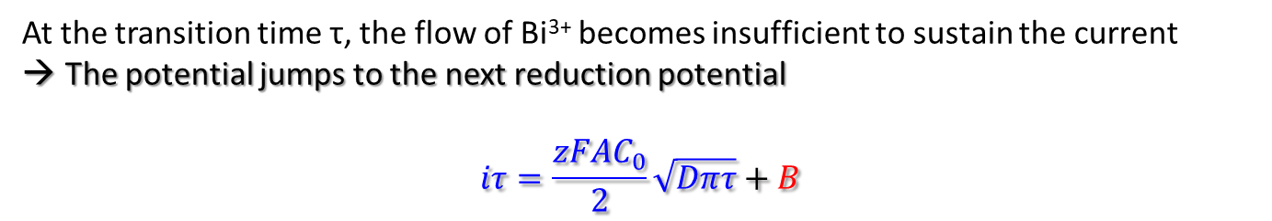

Exercise2: electrodeposition rate and current efficiency
Propose a protocole to measure the diffusion coefficient of Bi³⁺.
In electrochemical deposition, no steady state is reached !!!
A better protocole is the Sand-Bard method that corrects surface modifications
$$iτ$$
Potential
time
Surface effects (EDL, contaminants…)
$${Bi}^{3+}+3e^{−}⟶Bi$$
$$\frac{zFAC_{0}}{2}\sqrt{Dπ}$$
τ₁
τ₂
τ₃
τ₄
$$B$$
$$\sqrt{τ}$$
$${2H}^{+}+2e^{−}⟶H_{2}$$
At the transition time τ, the flow of Bi³⁺ becomes insufficient to sustain the current
The potential jumps to the next reduction potential
$$iτ=\frac{zFAC_{0}}{2}\sqrt{Dπτ}+B$$
Sand equation:
Bard surface correction

Slide 29
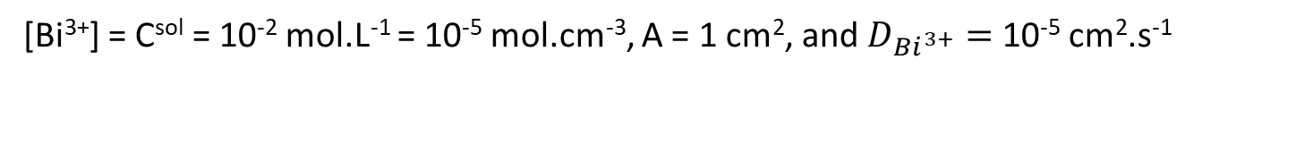
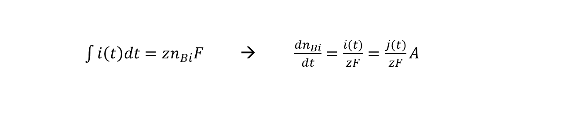
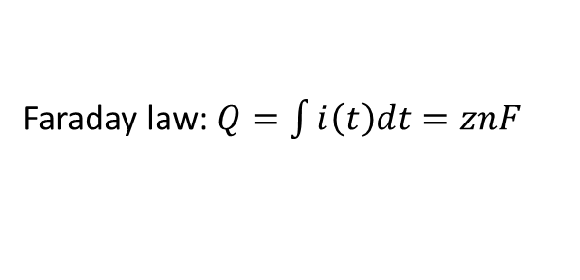
Exercise2: electrodeposition rate and current efficiency
2) Knowing that $D_{{Bi}^{3+}}=$ 10⁻⁵ cm².s⁻¹, express the deposition rate of bismuth in mol.s⁻¹ as a function of time under purely mass limiting regime and in the absence of convection.
[Bi³⁺] = C^{sol} = 10⁻² mol.L⁻¹ = 10⁻⁵ mol.cm⁻³, A = 1 cm², and $D_{{Bi}^{3+}}=$ 10⁻⁵ cm².s⁻¹
$\int{i\left(t\right)dt=zn_{Bi}F}$→ $\frac{{dn}_{Bi}}{dt}=\frac{i(t)}{zF}=\frac{j(t)}{zF}A$
Faraday law: $Q=\int{i\left(t\right)dt=znF}$
Cottrell law: $j_{lim}=zFC^{sol}\sqrt{\frac{D}{πt}}$

Slide 30
Exercise2: electrodeposition rate and current efficiency
2) Knowing that $D_{{Bi}^{3+}}=$ 10⁻⁵ cm².s⁻¹, express the deposition rate of bismuth in mol.s⁻¹ as a function of time under purely mass limiting regime and in the absence of convection.
[Bi³⁺] = C^{sol} = 10⁻² mol.L⁻¹ = 10⁻⁵ mol.cm⁻³, A = 1 cm², and $D_{{Bi}^{3+}}=$ 10⁻⁵ cm².s⁻¹
$\int{i\left(t\right)dt=zn_{Bi}F}$→ $\frac{{dn}_{Bi}}{dt}=\frac{i(t)}{zF}=\frac{j(t)}{zF}A$
$\frac{j(t)}{zF}A=AC^{sol}\sqrt{\frac{D}{πt}}$ → $\frac{{dn}_{Bi}}{dt}=1∗{10}^{−5}∗\sqrt{\frac{{10}^{−5}}{π}}∗t^{−1/2}$
Faraday law: $Q=\int{i\left(t\right)dt=znF}$
Cottrell law: $j_{lim}=zFC^{sol}\sqrt{\frac{D}{πt}}$

Slide 31




Exercise2: electrodeposition rate and current efficiency
3) Calculate the thickness of the deposit obtained after 1000 s of electroplating (M_{Bi} = 208.98 g.mol⁻¹ and $ρ_{Bi}$ = 9.79 g.cm⁻³).
[Bi³⁺] = C^{sol} = 10⁻⁵ mol.cm⁻³, A = 1 cm², $D_{{Bi}^{3+}}=$ 10⁻⁵ cm².s⁻¹, M_{Bi} = 208.98 g.mol⁻¹, and $ρ_{Bi}$ = 9.79 g.cm⁻³
$\int{i\left(t\right)dt=zn_{Bi}F}$ → $\frac{{dn}_{Bi}}{dt}=\frac{i(t)}{zF}=AC^{sol}\sqrt{\frac{D}{πt}}=1∗{10}^{−5}∗\sqrt{\frac{{10}^{−5}}{π}}∗t^{−1/2}$
Let us integrate: ${Δn}_{Bi}=AC^{sol}\sqrt{\frac{D}{π}} \int_{0}^{t}{t^{−1/2}}dt =2AC^{sol}\sqrt{\frac{D}{π}} \left[\sqrt{t_{2}}−\sqrt{t_{1}}\right]$
${Δn}_{Bi}=2∗1∗{10}^{−5}∗\sqrt{\frac{{10}^{−5}}{π}}∗\left[\sqrt{1000}−\sqrt{0}\right]≈1.128∙{10}^{−6}$ mol
$d=\frac{{Δn}_{Bi}∙M_{Bi}}{A∙ρ_{Bi}}≈2.41∙{10}^{−5} cm =241 nm$
Faraday law: $Q=\int{i\left(t\right)dt=znF}$
Cottrell law: $j_{lim}=zFC^{sol}\sqrt{\frac{D}{πt}}$

Slide 32


Exercise2: electrodeposition rate and current efficiency
4) After an electrodeposition of 1000 s, a total of 0.4 C was integrated from the chronoamperometry data. Calculate the electrodeposition efficiency.
[Bi³⁺] = C^{sol} = 10⁻² M, A = 1 cm², $D_{{Bi}^{3+}}=$ 10⁻⁵ cm².s⁻¹, M_{Bi} = 208.98 g.mol⁻¹, and $ρ_{Bi}$ = 9.79 g.cm⁻³
$$Efficiency=\frac{Q_{ECD}}{Q_{Meas}}=\frac{zn_{Bi}F}{\int{i\left(t\right)dt}}$$
$n_{Bi}=≈1.128∙{10}^{−6}$ mol
$$Efficiency≈\frac{3∗1.128∙{10}^{−6}∗96485}{0.4}≈\frac{0.3266}{0.4}≈0.8165$$
Only 81.65 % of the electrons participated to the ECD of bismuth.
Faraday law: $Q=\int{i\left(t\right)dt=znF}$
Cottrell law: $j_{lim}=zFC^{sol}\sqrt{\frac{D}{πt}}$

Slide 33

Exercise2: electrodeposition rate and current efficiency
5) What could have happened to the other electrons? How could you improve the efficiency?
Capacitive current (double layer charging) but negligible for long DC electroplating
Uncontrolled side reactions:
→ Reduction of dissolved oxygen $O_{2}+2H^{+}+{2e}^{−}⇀H_{2}O_{2}$
$H_{2}O_{2}+2H^{+}+{2e}^{−}⇀{2H}_{2}O$
→ Hydrogen evolution ${2H}_{3}O^{+}+{2e}^{−}⇀H_{2}+{2H}_{2}O$
→ Co-deposition of other metals $M^{z+}+ze^{−}⇀M^{0}$
→ Partial reduction of metal ions $M^{z+}+ye^{−}⇀M^{\left(z−y\right)+}$
→ Reduction of surface oxides $M_{x}O_{y}+{2yH}_{3}O^{+}{+2ye}^{−}⇀{xM+3yH}_{2}O$
→ Partial redissolution or detachment of the deposit (corrosion)
Solutions: Argon degassing, optimize the bath formulation (pH, precursors, concentrations), optimize electroplating conditions (electrode potential, temperature, convection), optimize the surface state of the substrate

